Slide 1
Universidade Federal da
Integração Latino-Americana
APRESENTAÇÃO

Slide 2
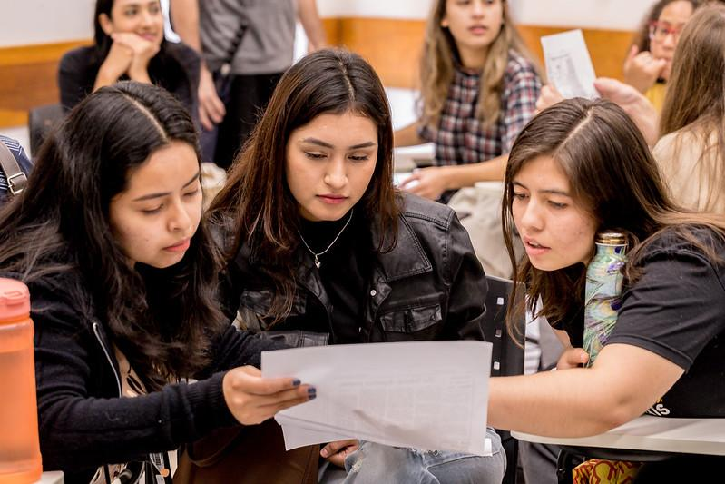
WHO ARE WE?
Founded in 2010, the Federal University for Latin American Integration (UNILA) is a Brazilian, public and tuition-free university with an international character.
Its mission is to contribute to Latin American and Caribbean integration through shared knowledge and solidarity-based cooperation.

Slide 3
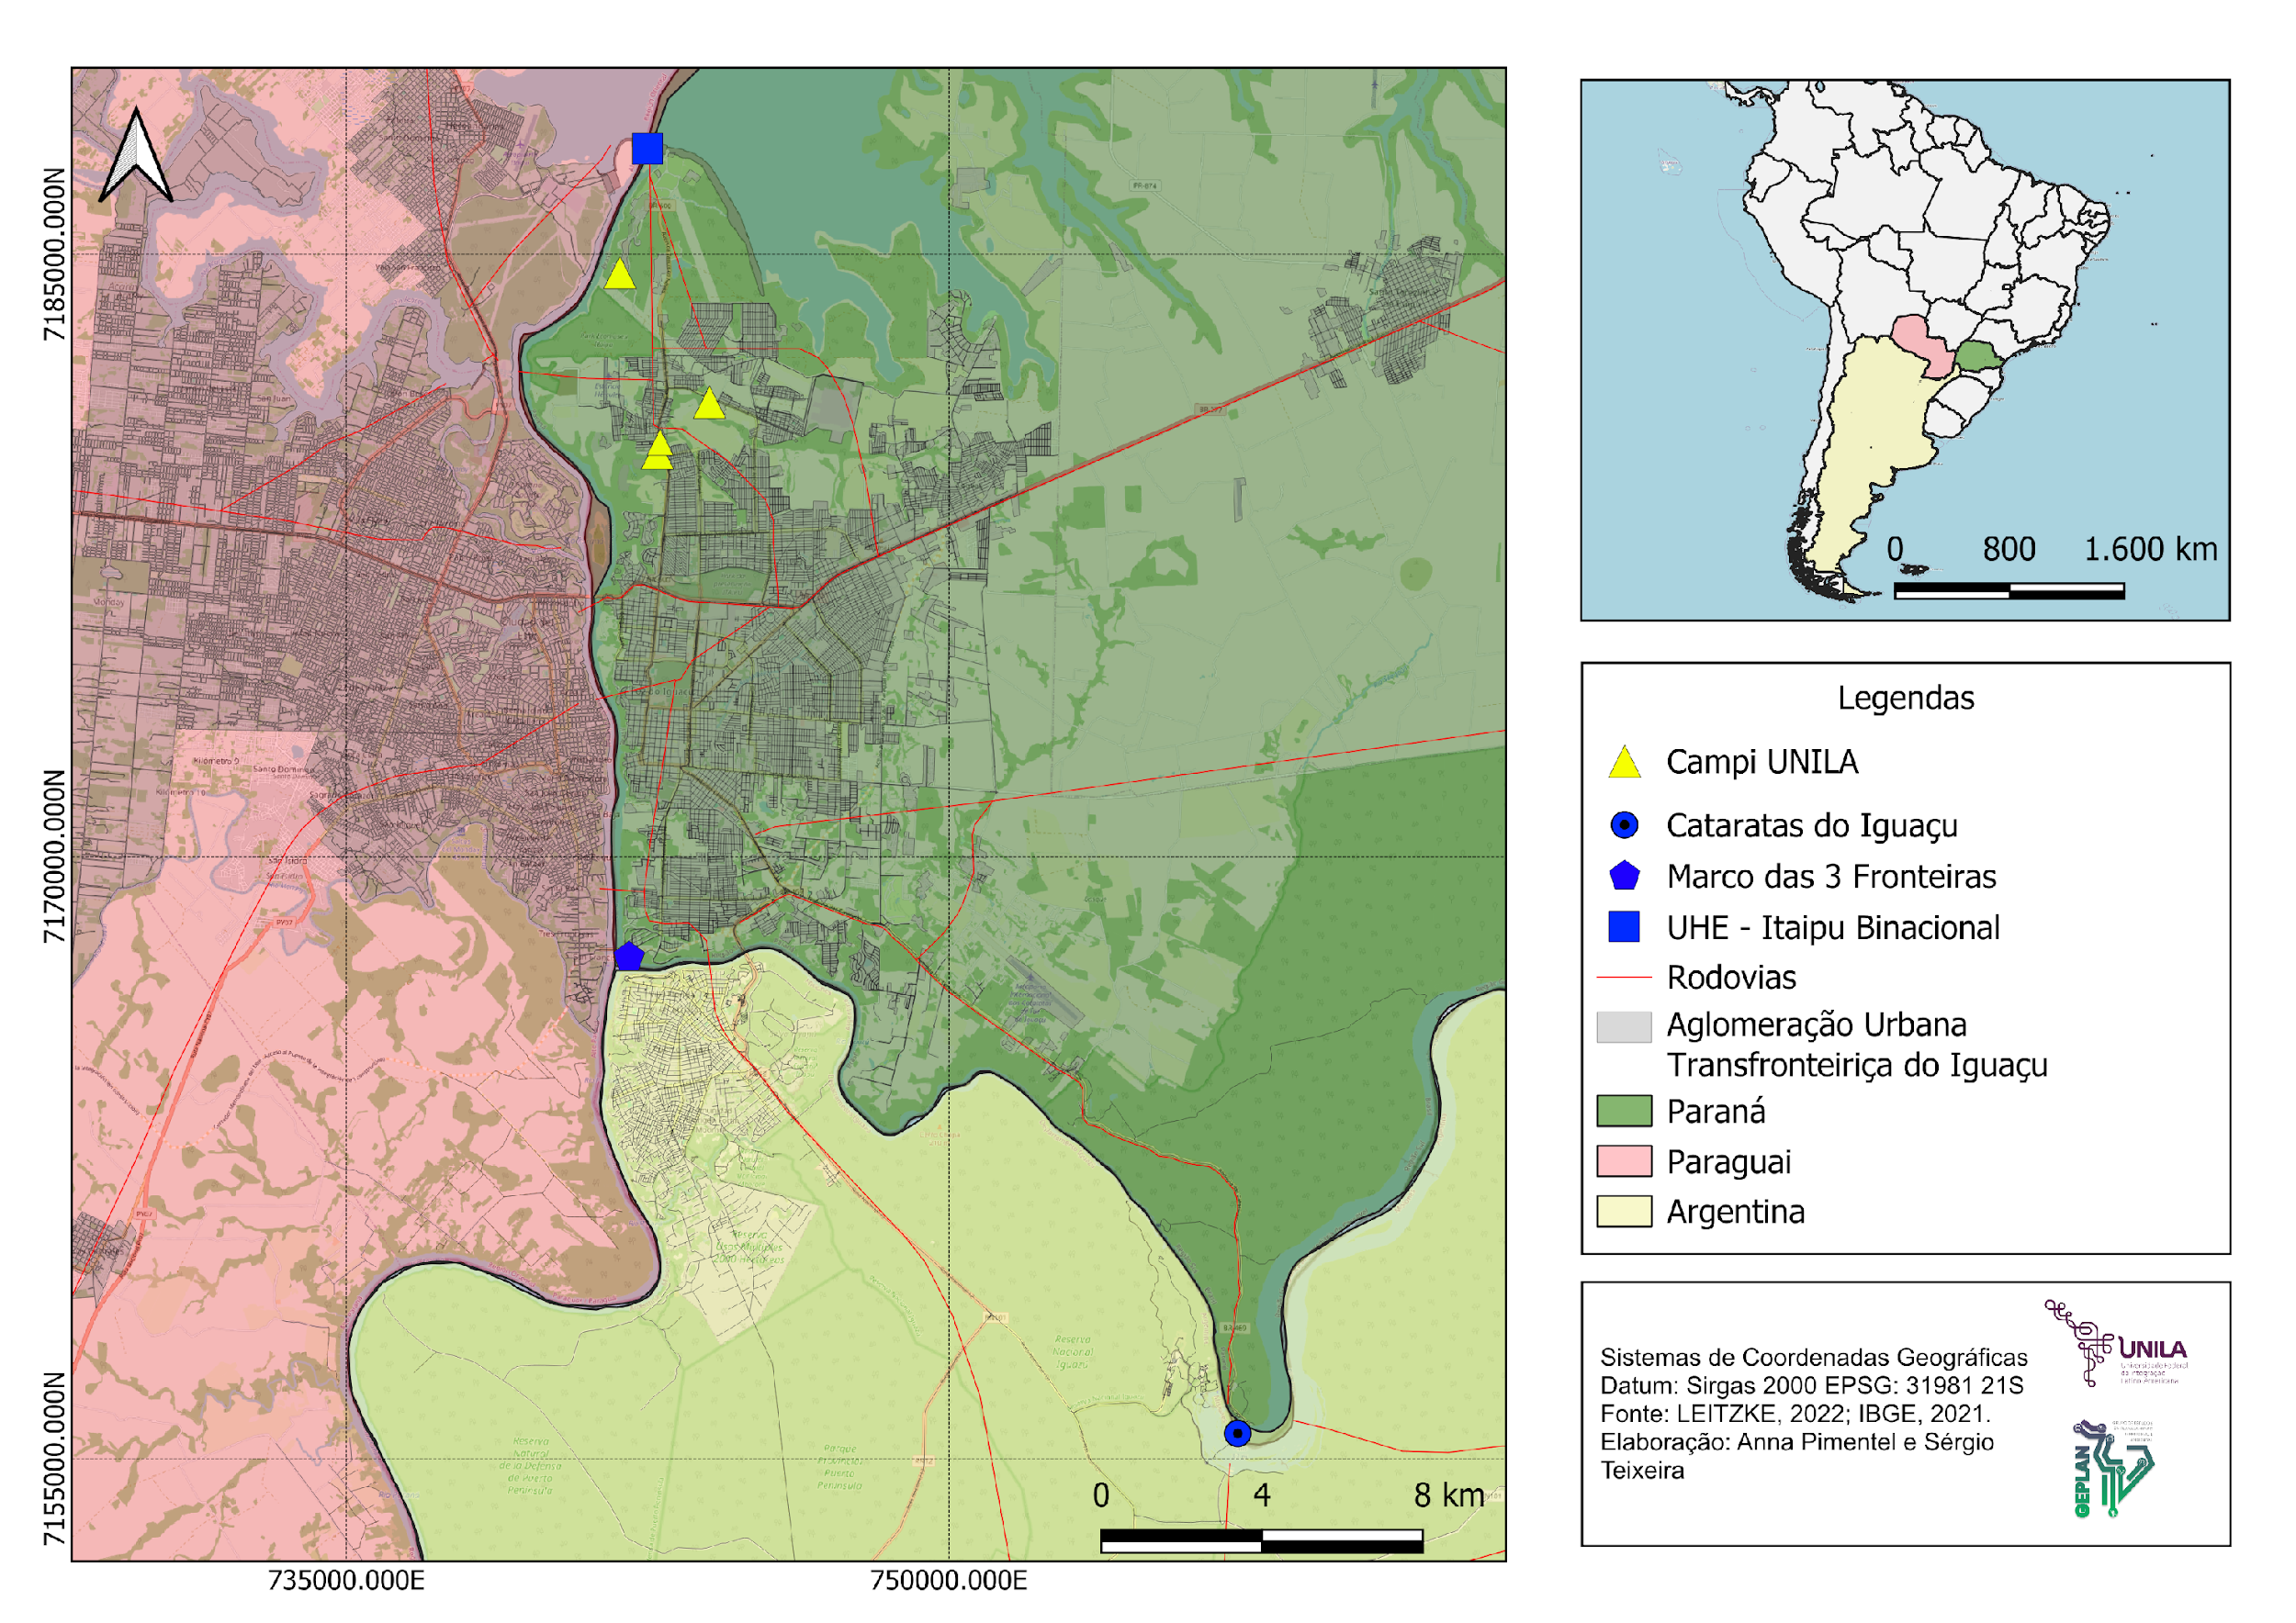
WHO ARE WE?
UNILA is located in the city of Foz do Iguaçu, in the westernmost part of the state of Paraná, in the Trinational Region formed by Argentina, Brazil and Paraguay.
The location of a university dedicated to the theme of integration holds both strategic and symbolic importance in the region.

Slide 4
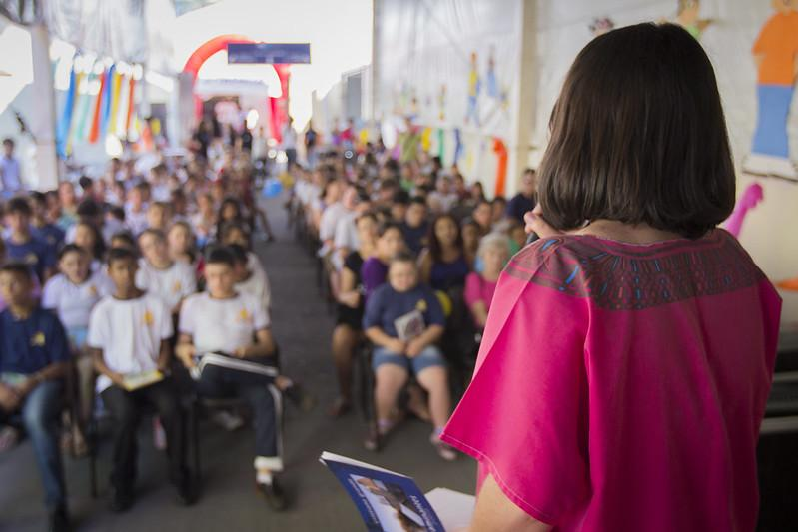
WHO ARE WE?
UNILA’s distinctive feature is its international character, with a focus on major Latin American issues. The institution’s goal is for half of its students to come from other Latin American and Caribbean countries.
All programs are designed to train professionals with a broad understanding of the continent’s realities, so that in the future, graduates can contribute within their fields by proposing solutions to the challenges faced across various Latin American and Caribbean countries.
In addition, UNILA promotes bilingualism – with Portuguese and Spanish as its main languages – along with intercultural exchange and a strong emphasis on interdisciplinary approaches.

Slide 5
TEACHING
UNILA offers 29 undergraduate programs, 9 specialization programs (lato sensu graduate programs), and has stricto sensu graduate programs, including 13 master’s degrees and 2 doctoral degrees, in a wide range of fields.
The selection process for undergraduate courses for Brazilian students is conducted through the Unified Selection System (Sisu), while international students apply through UNILA’s International Selection Process (PSI), based on a specific public call for applications.
Graduate program admissions have its own admissions process, based on specific calls for applications.
Currently, UNILA has over 4,241 enrolled students across undergraduate and graduate levels, coming from more than 30 countries.

Slide 6
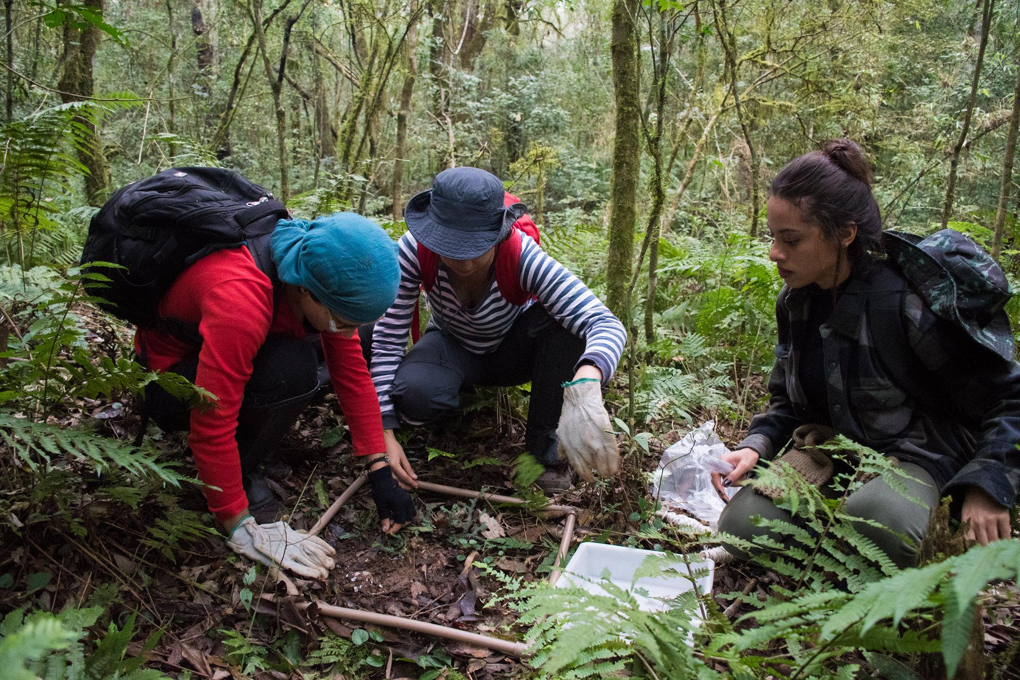
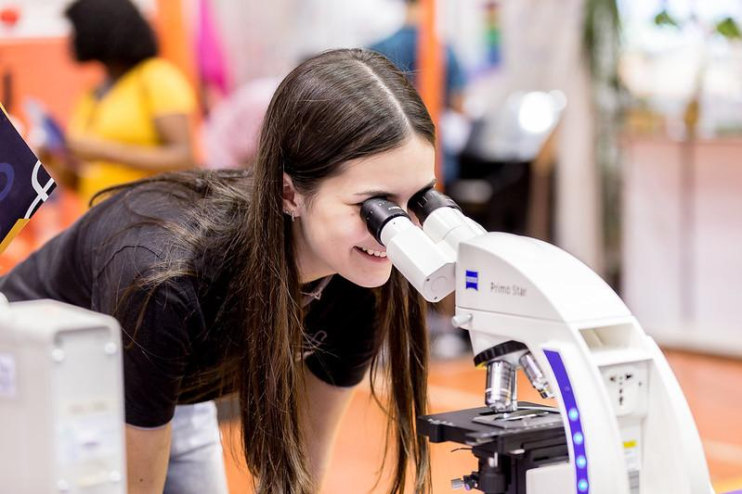
RESEARCH AND COMMUNITY OUTREACH
In addition to education, as a public university, UNILA is also grounded in research and community outreach.
UNILA currently has around 300 extension projects underway, involving over 1,000 students, contributing to the production of knowledge in both local and regional communities.
The academic community at UNILA generates intellectual and scientific output on a wide range of topics relevant to society, with both local and international impact. With over 300 registered research projects in the past year alone, UNILA contributes to the understanding of realities as well as to the process of Latin American and Caribbean integration.

Slide 7
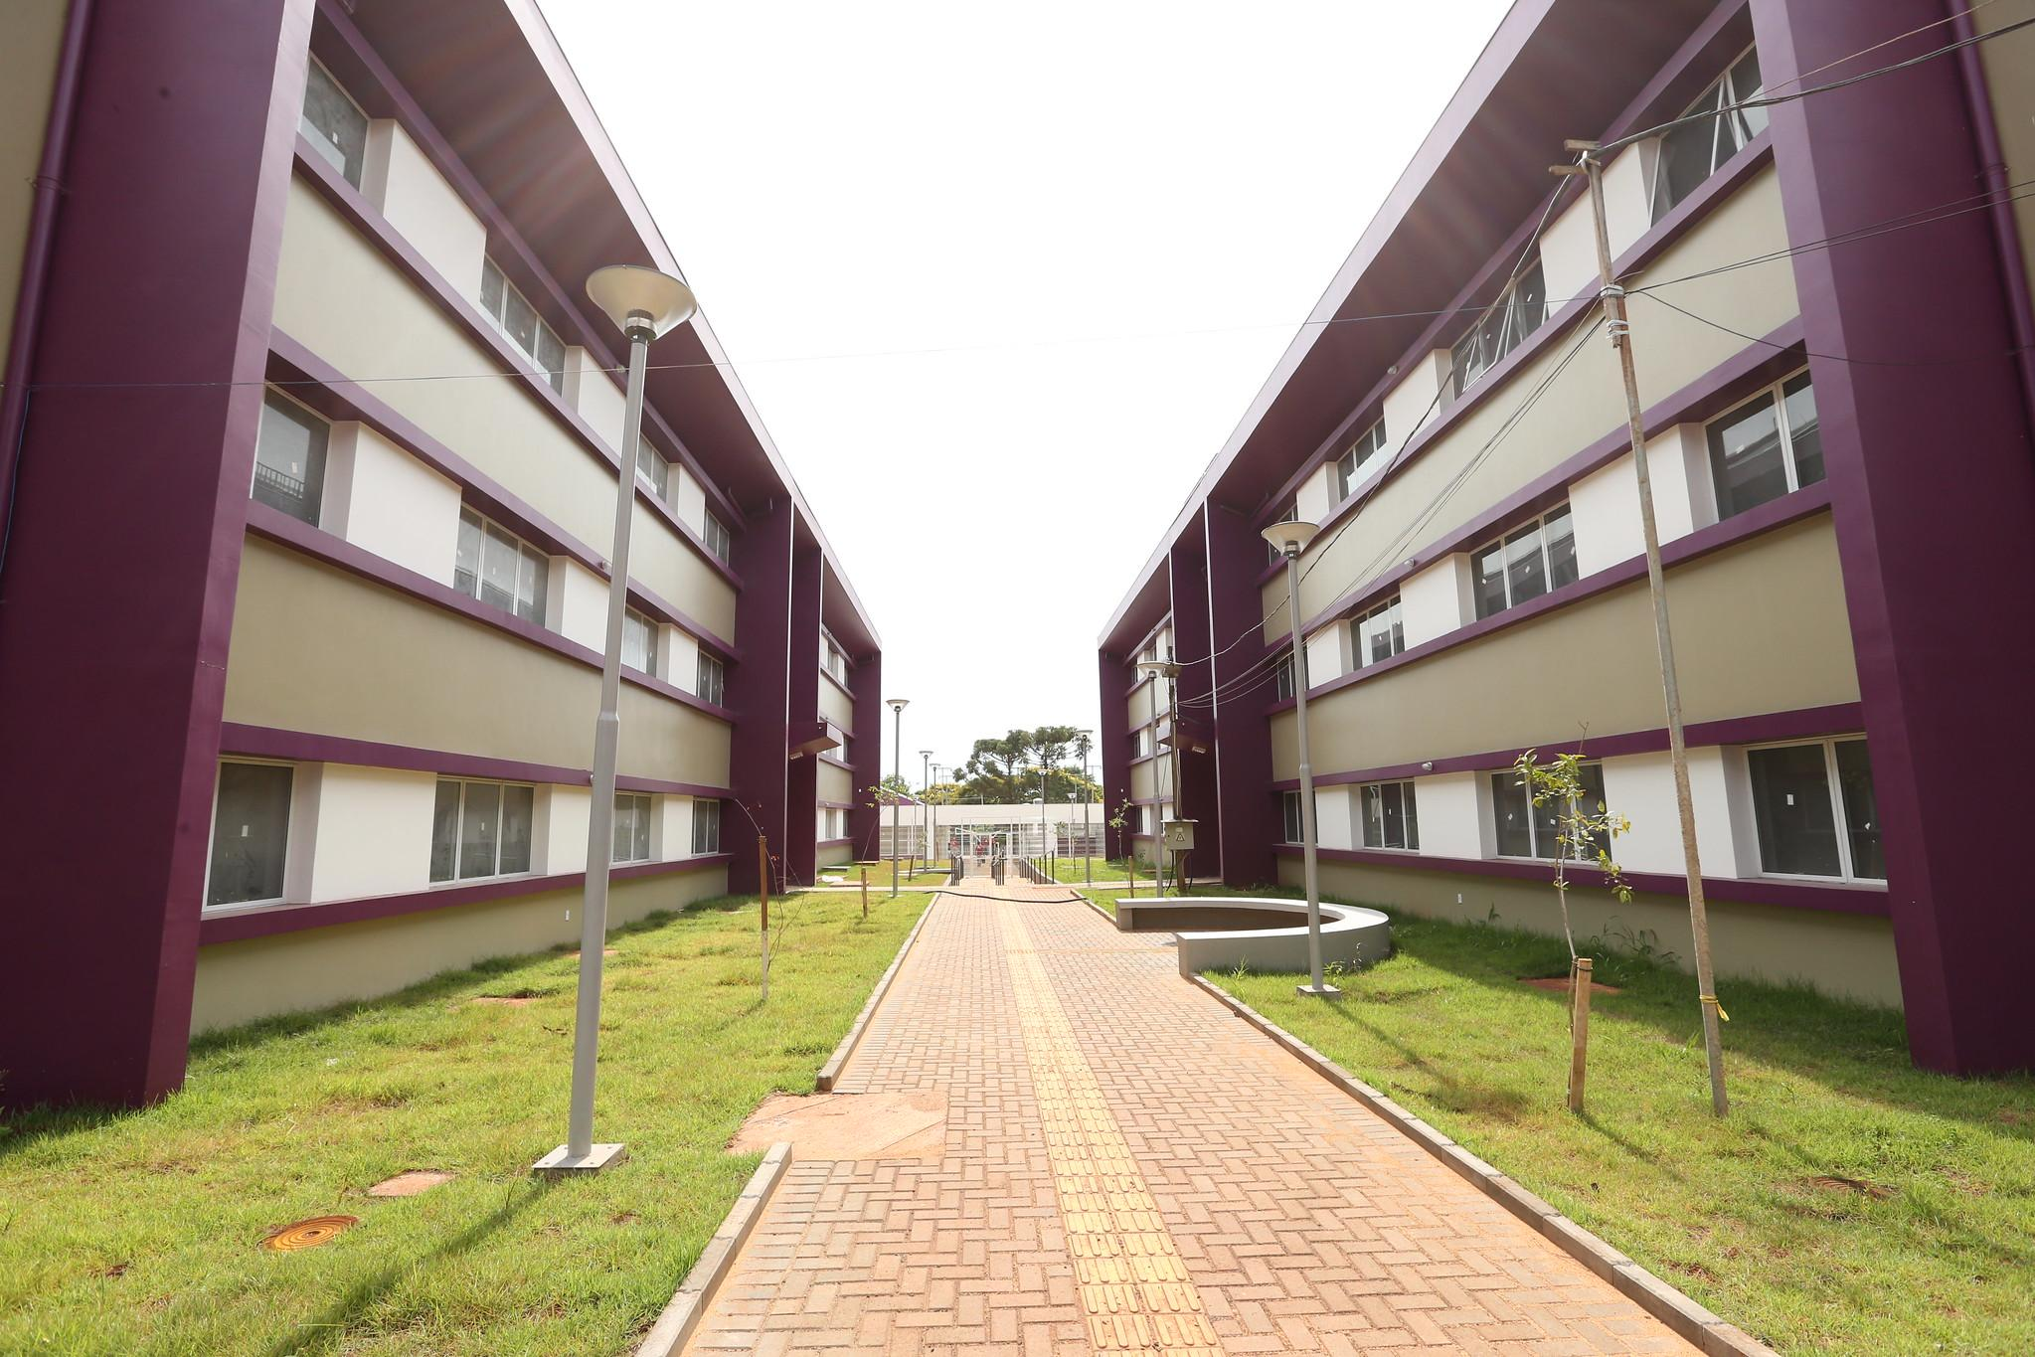
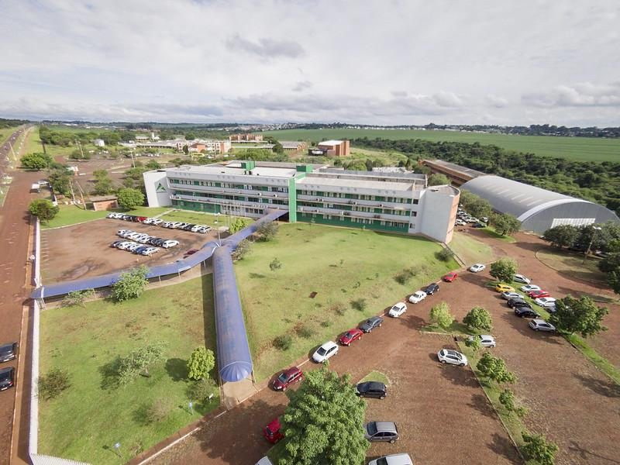
INFRASTRUCTURE
The University operates its activities in five units.
Integration Campus
Jardim Universitário Unit

Slide 8
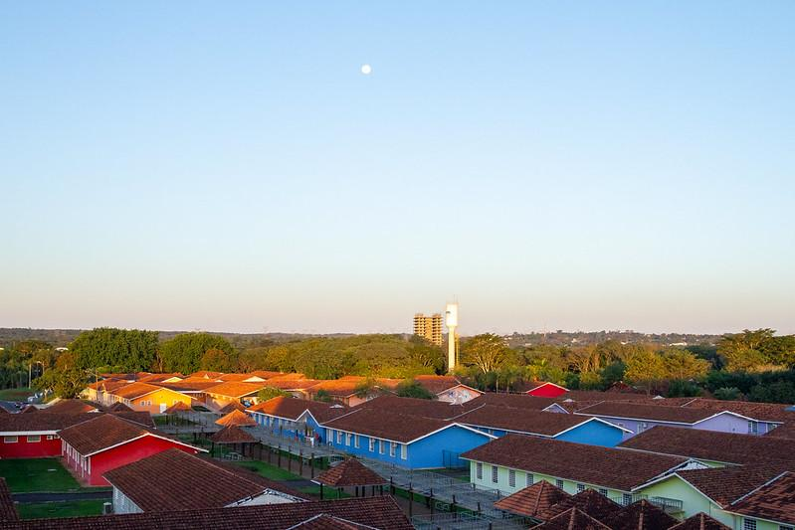
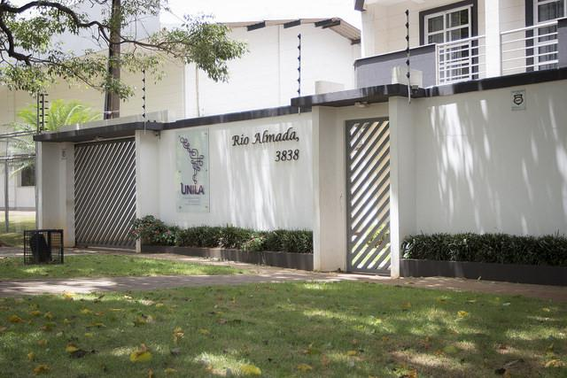
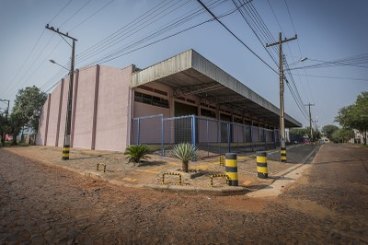
INFRASTRUCTURE
The University operates its activities in five units.
Parquetec Unit
Rio Almada Building Unit
Portal da Foz Unit Warehouse

Slide 9
CAMPUS ARANDU
The construction of the new campus of the Federal University of Latin American Integration (UNILA), called Campus Arandu, was resumed after a cooperation agreement between UNOPS, a UN agency specialized in infrastructure, and the Federal Government, through the Ministry of Education and UNILA. The financial resources were provided by Itaipu Binacional.
UNOPS is working on the implementation of the first phase of the works, which includes the completion of the Central Building, the University Restaurant, and the Classroom Block. The project is set to have phased completions over the next 3 years.

Slide 10
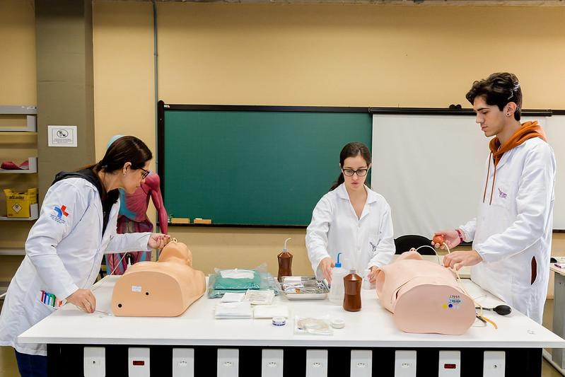
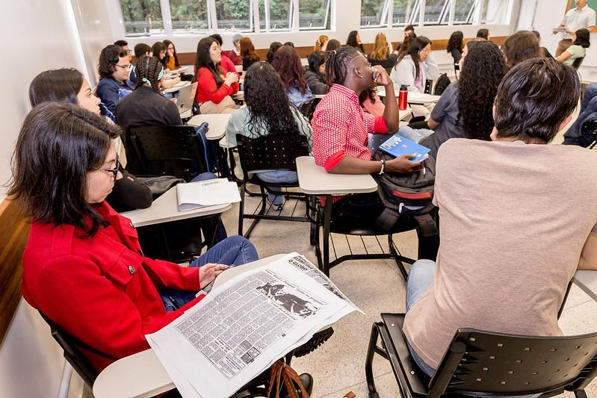
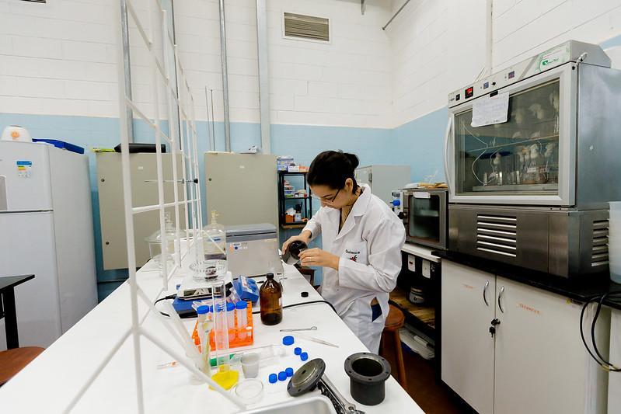
INFRASTRUCTURE
The activities take place in an infrastructure that provides, in addition to classrooms, laboratory spaces dedicated to various areas.

Slide 11
INFRASTRUCTURE
UNILA also has BIUNILA, the university's library, with a collection available in two units. It also offers the "Minha Biblioteca" platform, a digital resource for accessing academic and technical ebooks. The platform provides over 10,000 titles from 16 major publishers and 42 editorial imprints, covering various areas of knowledge.

Slide 12
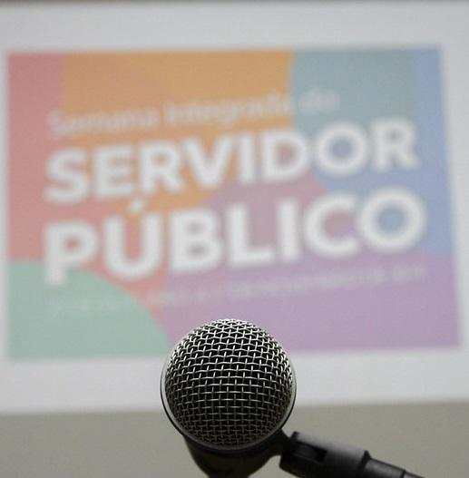
PEOPLE
Currently, the University has a staff of approximately one thousand employees: over 400 professors – about 90% of whom hold master's or doctoral degrees – and more than 500 administrative and technical staff.

Slide 13
Thanks!
Avenida Tarquínio Joslin dos Santos, 1000 - Polo Universitário
CEP: 85870-650 | Foz do Iguaçu - Paraná
https://portal.unila.edu.br

